Slide 1

Presented by:
SATHYA VB

Slide 2

What is Big Data?
Big Data
.
Big data is the huge amount of data generating exponentially everyday and the size is increasing upto zetabytes of data
Bigdata cannot be stored in rdbms
Google invented gfs to store the data
Later it was derieved as hdfs

Slide 3
5v’s
Volume
Velocity
Variety
Value
Veracity

Slide 4
Volume
The quantity of generated and stored data. The size of the data determines the value and potential insight- and whether it can actually be considered big data or not.
Variety
The type and nature of the data. This helps people who analyse it to effectively use the resulting insight.
Velocity
In this context, the speed at which the data is generated and processed to meet the demands and challenges that lie in the path of growth and development.
Value
Inconsistency of the data set can hamper processes to handle and manage it.
Veracity
The data quality of captured data can vary greatly, affecting the accurate analysis.

Slide 5
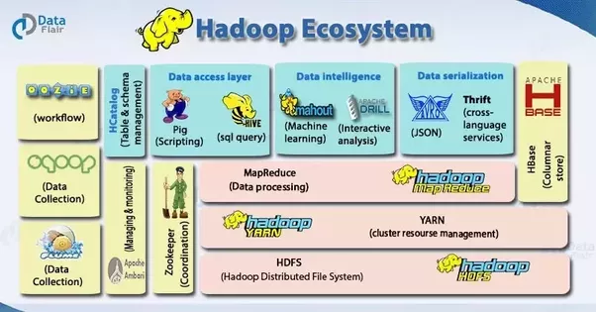

Slide 6
Hadoop is not Big Data.
Hadoop is not a database.
Apache Hadoop is a open source platform/framework
Which allows the user to quickly write and test distributed systems
HDFS: Hadoop Distributed File System
Makes our job easy to store the data on commodity hardware
Intended for large files & batch inserts
MapReduce – For parallel processing

Slide 7

HISTORY
Apache Nutch was started in the year 2002 by Doug Cutting. Nutch was based on sort/merge processing.
publication of a paper in 2003 that described the architecture of the Google’s Distributed Filesystem, called GFS.
In the year 2004, they started writing the open source implementation called Nutch Distributed Filesystem (NDFS). In the same year Google published a paper that introduces MapReduce to the world.
2004 : Initial versions of what is now Hadoop Distributed FileSystem and MapReduce implemented by Doug Cutting and Mike Cafarella.

Slide 8
WHY HADOOP?
SCALABLE: Can store and distribute very large data sets across hundreds of inexpensive servers that operate in parallel.
ECONOMICAL: It distributes the data and processing across clusters of commonly available computers (in thousands).
EFFICIENT: By distributing the data, it can process it in parallel on the nodes where the data is located.
RELIABLE: It automatically maintains multiple copies of data and automatically redeploys computing tasks based on failures.
FREE: Apache Hadoop is open source framework.

Slide 9
HDFS
HDFS is a Hadoop Distributed File System designed for storing very large files with streaming data access patterns, running on clusters of commodity hardware.
HDFS Architecture follows a Master/Slave Architecture, where a cluster comprises of a single NameNode (Master node) and all the other nodes are DataNodes (Slave nodes).
NameNode:
Records the metadata of all the files stored in the cluster. There are two files associated with the metadata:
FsImage: It contains the complete state of the file system namespace since the start of the NameNode.
EditLogs: It contains all the recent modifications made to the file system with respect to the most recent FsImage.
The NameNode is also responsible to take care of the replication factor of all the blocks
DataNode:
The actual data is stored on DataNodes.
The DataNodes perform the low-level read and write requests from the file system’s clients.
Unlike NameNode, DataNode is a commodity hardware, that is, a non-expensive system.

Slide 10
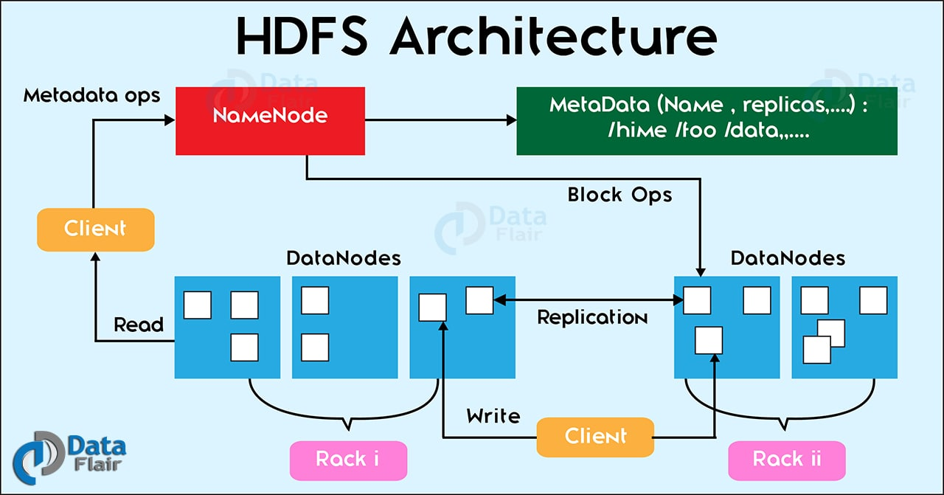

Slide 11
Secondary Namenode:
It is not a backup Namenode, It is just a helper daemon.
It is responsible for combining the EditLogs with FsImage from the NameNode.
It downloads the EditLogs from the NameNode at regular intervals and applies to FsImage. The new FsImage is copied back to the NameNode, which is used whenever the NameNode is started the next time.
Hence, Secondary NameNode performs regular checkpoints in HDFS. Therefore, it is also called CheckpointNode.
Blocks:
Blocks are the physical representation of data.
Blocks are the nothing but the smallest continuous location on your hard drive where data is stored.
HDFS stores each file as blocks which are scattered throughout the Apache Hadoop cluster. The default size of each block is 128 MB in Apache Hadoop 2.x.

Slide 12
Rack Awareness:
In a large cluster of Hadoop, in order to improve the network traffic while reading/writing HDFS file, namenode chooses the datanode which is closer to the same rack or nearby rack to Read/Write request.
Namenode achieves rack information by maintaining the rack id’s of each datanode.
This concept that chooses closer datanodes based on the rack information is called Rack Awareness in Hadoop.

Slide 13
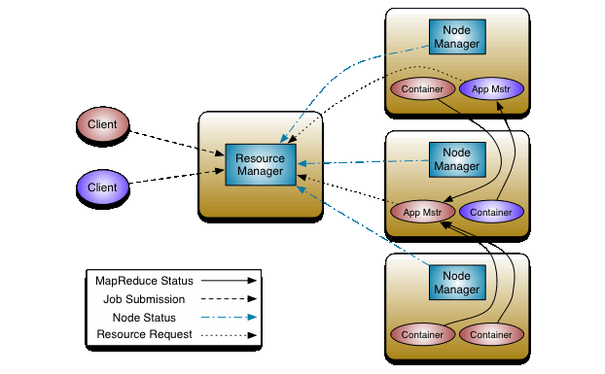
YARN(Yet Another Resource Negotiator)

Slide 14
YARN(Yet Another Resource Negotiator)
Hadoop YARN is described as a clustering platform that helps to manage resources and schedule tasks.
Framework to develop and execute distributed processing applications.
Resource Manager:
Resource Manager is the master. It knows where the slaves are located and how many resources they have. Two main components:
Application manager-Responsible for accepting Job submissions.
Scheduler-Scheduling the resources based on resource requirements.
Node Manager:
Node Manager is the slave. When it starts, it announces himself to the Resource Manager. Periodically, It sends an heartbeat to the Resource Manager.
The NodeManager is responsible for launching and managing containers on a node. Containers execute tasks as specified by the AppMaster.

Slide 15
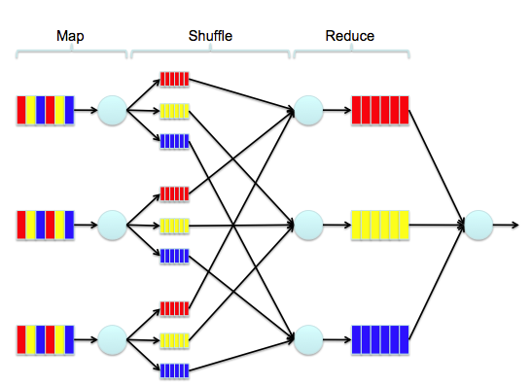
MapReduce divides a task into small parts and assigns them to many computers. Later, the results are collected at one place and integrated to form the result dataset.

Slide 16
Hadoop Input Format:
How the input files are split up and read in Hadoop is defined by the InputFormat.
An Hadoop InputFormat is the first component in Map-Reduce, it is responsible for creating the input splits and dividing them into records.
We have 2 methods to get the data to mapper in MapReduce: getsplits() and createRecordReader()
Input Splits:
InputSplit in Hadoop MapReduce is the logical representation of data.
Unit of work that contains a single map task in a MapReduce program.
InputSplit doesn’t contain actual data, but a reference to the data.
Record Reader:
Communicates with the InputSplit and converts it into records which are in form of key-value pairs that are suitable for reading by the mapper.
By default, RecordReader uses TextInputFormat for converting data into a key-value pair.

Slide 17
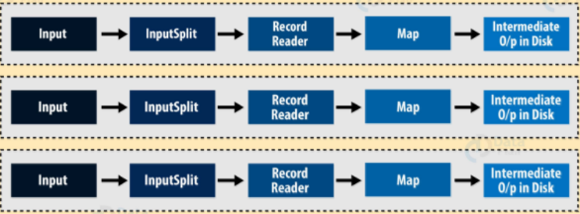
Mapper:
Mapper task processes each input record and it generates a new <key, value> pairs. The <key, value> pairs can be completely different from the input pair.
No. of Mapper= {(total data size)/ (input split size)}
Combiner:
Combiner plays a key role in reducing network congestion.
Known as ‘Mini-reducer’.
Process the output data from the Mapper, before passing it to Reducer.
Improves the overall performance of the reducer.

Slide 18
Partitioner:
A partitioner partitions the key-value pairs of intermediate Map-outputs.
Partitions the data using a user-defined condition, which works like a hash function.
Determines in which reducer a (key, value) pair, output of the map phase, will be sent.
The total number of partitions is same as the number of Reducer tasks for the job.
Sort and Shuffling:
Shuffling is the process by which it transfers mapper intermediate output to the reducer.
Shuffling can start even before the map phase has finished. So this saves some time and completes the tasks in lesser time.
Before starting of reducer, all intermediate key-value pairs generated by mapper get sorted by key and not by value.
Sorting in a MapReduce job helps reducer to easily distinguish when a new reduce task should start.
Sort and Shuffling is done by Reducer phase.

Slide 19
Reducer:
Called once for each unique key.
Gets a list of all values associated with a key as input.
Reducer takes the output of the Mapper (intermediate key-value pair) process each of them to generate the output.
The output of the reducer is the final output, which is stored in HDFS.
Reducers run in parallel since they are independent of one another.
Record Writer:
RecordWriter classes handle the job of taking an individual key-value pair and writing it to the location prepared by the OutputFormat.
There are two main functions to a RecordWriter implements: 'write' and 'close'.
The ‘write' function takes key-values from the MapReduce job and writes the bytes to disk.
The 'close' function closes the Hadoop data stream to the output file.
The default RecordWriter is LineRecordWriter

Slide 20
Hadoop Output Format:
The way the output key-value pairs are written in output files by RecordWriter is determined by the OutputFormat.
OutputFormat describes the output-specification for a MapReduce jobs.
FileOutputFormat.setOutputPath() method is used to set the output directory.

Slide 21

HIVE
It is a platform used to develop SQL type scripts to do MapReduce operations.
Initially Hive was developed by Facebook, later the Apache Software Foundation took it up and developed it further as an open source under the name Apache Hive. For example, Amazon uses it in Amazon Elastic MapReduce.

Slide 22
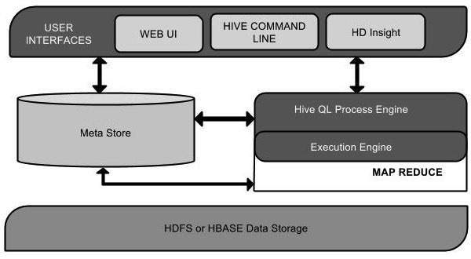

Slide 23
Meta Store:
Hive chooses respective database servers to store the schema or Metadata of tables, databases, columns in a table, their data types.
HiveQL Process Engine:
HiveQL is similar to SQL for querying on schema info on the Metastore.
Instead of writing MapReduce program in Java, we can write a query for MapReduce job and process it.
Execution Engine:
The conjunction part of HiveQL process Engine and MapReduce is Hive Execution Engine. Execution engine processes the query and generates results as same as MapReduce results.
HDFS or HBASE:
Hadoop distributed file system or HBASE are the data storage techniques to store data into file system.

Slide 24
Partitioning:
Apache Hive organizes tables into partitions for grouping same type of data together based on a column or partition key.
Using partition we can make it faster to do queries on slices of the data.
Bucketing:
In Hive Tables or partition are subdivided into buckets based on the hash function of a column in the table to give extra structure to the data that may be used for more efficient queries.

Slide 25
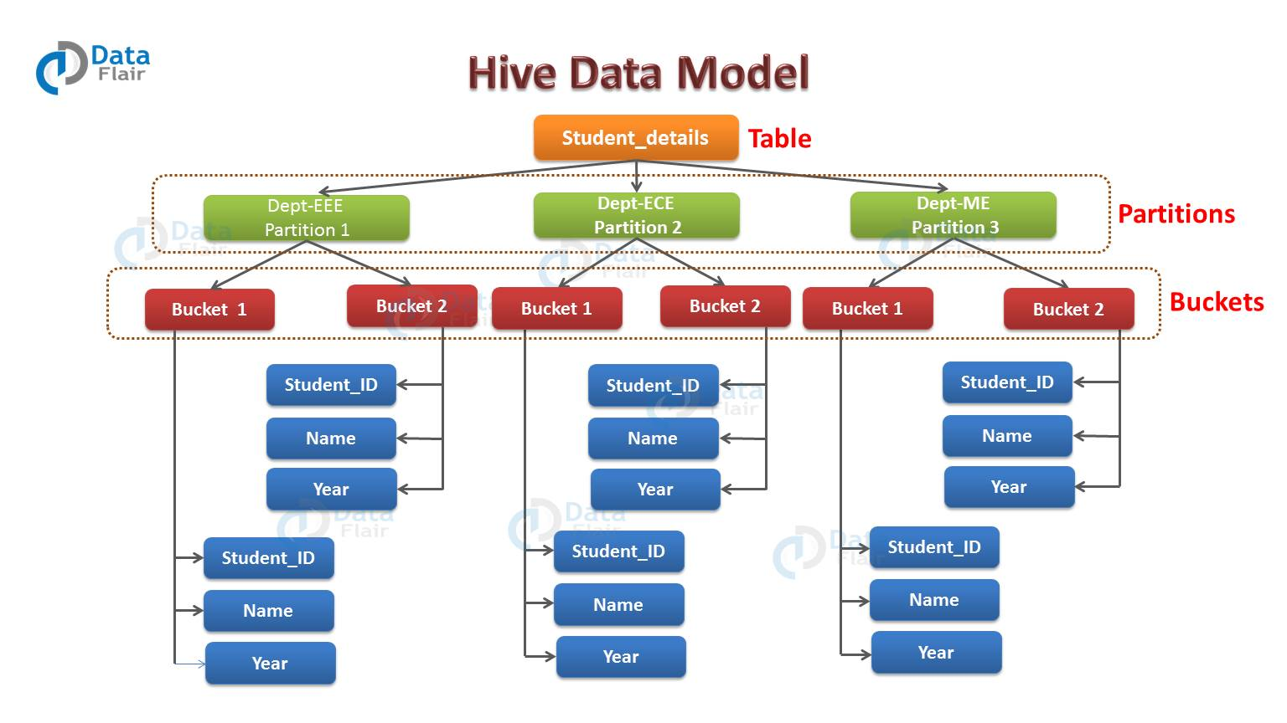

Slide 26

PIG
Pig is the high level data flow language
Provides the data flow
User can create their own function for special set of function
Pig components are grunt shell,pig latin ,pig server
Apache Pig analyzes all kinds of data, both structured as well as unstructured. It stores the results in HDFS.
Apache Pig provides many built-in operators to support data operations like joins, filters, ordering, etc. In addition, it also provides nested data types like tuples, bags, and maps that are missing from MapReduce.
Provides operators to perform ETL (Extract, Transform, and Load) functions.

Slide 27
Parser:
The Parser handles the Pig Scripts. Hence it actually checks the syntax of the script. Output of the parser will be a Directed Graph.
Optimizer
The logical optimizer then receives the logical plan. It carries out the logical optimization such as projection and pushes down.
Compiler
The compiler converts the logical plan into a series of MapReduce jobs.
Execution Engine
In the end, the MapReduce jobs get submitted to Hadoop in a sorted order. Therefore these MapReduce jobs execute on the Hadoop producing the desired results.
Tuples:
A record which contains an ordered set of fields is a tuple. A tuple is same as the row in a table of RDBMS.
Bag:
A bag contains an unordered set of tuples. Therefore, a collection of tuples (non-unique) can be a bag. Each tuple may have any number of fields. We can represent the bag as ‘{}’. It is same as a table in RDBMS.

Slide 28
Sqoop
Sqoop is a tool designed to transfer data between Hadoop and relational database servers.
It is used to import data from relational databases such as MySQL, Oracle to Hadoop HDFS, and export from Hadoop file system to relational databases.
The import tool imports individual tables from RDBMS to HDFS. Each row in a table is treated as a record in HDFS. All records are stored as text data in text files or as binary data in Avro and Sequence files.
The export tool exports a set of files from HDFS back to an RDBMS. The files given as input to Sqoop contain records, which are called as rows in table. Those are read and parsed into a set of records and delimited with user-specified delimiter.

Slide 29
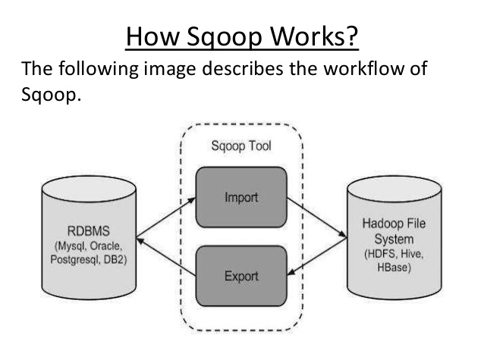

Slide 30
H1-B Case Study
Project overview: The H1B is an employment-based, non-immigrant visa category for temporary foreign workers in the United States. For a foreign national to apply for H1B visa, an US employer must offer a job and petition for H1B visa with the US immigration department. This is the most common visa status applied for and held by international students once they complete college/ higher education (Masters, Ph.D.) and work in a full-time position.
We will be performing analysis on the H1B visa applicants between the years 2011-2016. After analysing the data, we can derive the following facts.

Slide 31


